Slide 1
AGENDA
Evaluation of investment in a Hollywood
movie using Movies Dataset
Presenters (Data Analysts at DataPros):
Hridita Rubyat
Jahnavi Patnala
Shreya Joshi
Vishaal Sai Devishetty
DataPros Pvt. Ltd.
Understanding the world,
one dataset at a time!

Slide 2
Context
Who - Head of Finance of DataPros Pvt. Ltd., a private investment firm.
What - The firm has received a proposal from a new director to invest in the production of a Hollywood movie. The amateur director has no history to support his claim of making a profitable Adventure/Action genre movie with Thor from Marvel and Superman from DC universe. The Head of Finance wants his Data Analysts to assess the prospect of success of this movie.
How - We will use the lifetime gross of over 3000 movies to compare and establish
Action and Adventure are the highest grossing genres
2a) Majority of the earning for the highest grossing distributors come from Action and Adventure movies
2b) There is a steadily increasing interest in Superhero movies within Action and Adventure genres.
3) Action and Adventure movies are frequently rated PG-13 which restricts the audience. Does this limit the audience and potentially impact profitability?
4) Lastly, are Thor and Superman profitable superheroes?

Slide 3
Storyboard
Issue
We want to assess the prospect of success of an Adventure/Action movie with Thor and Superman.
Defining the problem
The amateur director has no release history at the box office to support the bankability of his proposed movie.
The returns on investment on an Adventure/Action movie with Thor and Superman need to be assessed based on the historical collection of similar movies.
Solutions
Invest in the movie based on
The historical evidence of gross collection of similar movies in box office
Casting Spiderman and Batman: Spiderman and Batman being the most popular and high grossing superheroes, are ideal for the movie, as compared to the proposed Thor and Superman.
Decline the proposal since the director has no proven history that shows his work.
Recommendation
Invest in the movie if Spiderman and Batman are cast as opposed to Thor and Superman.

Slide 4
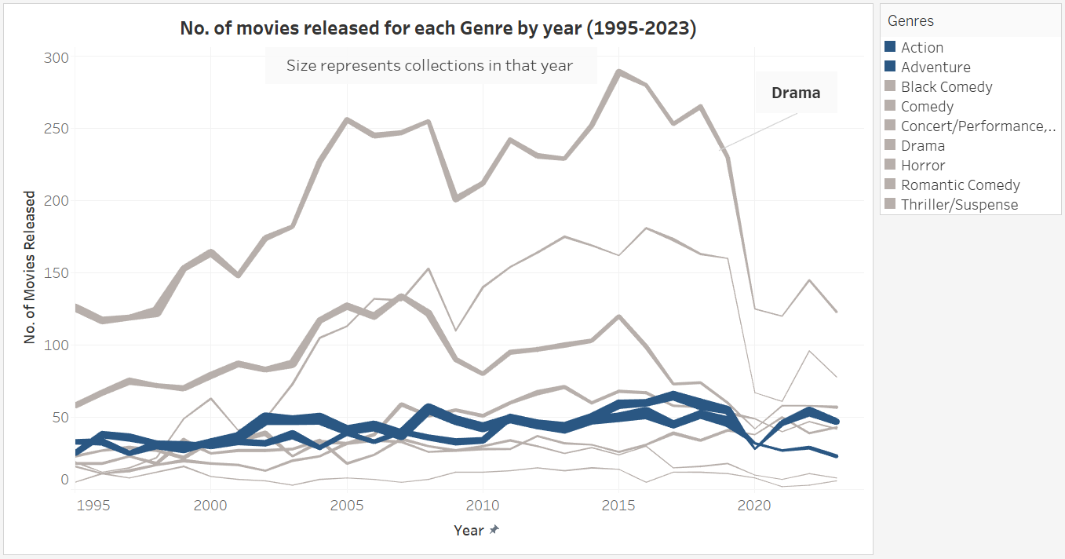
Genres | Distributors | MPAA Ratings | Superheroes | Recommendation
Key Takeaway: Action and Adventure Genres have been consistently performing well from 1995 till 2023.

Slide 5
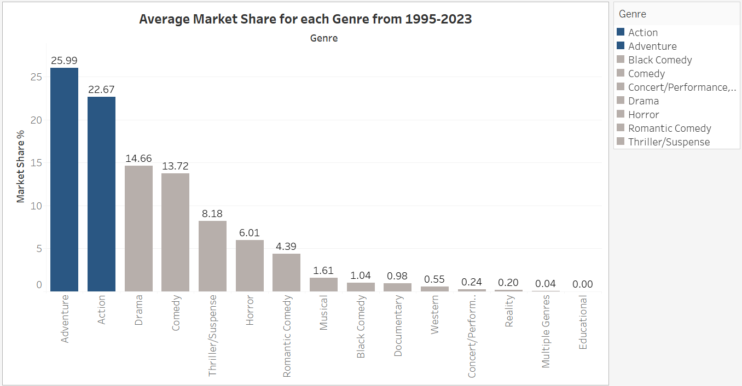
Genres | Distributors | MPAA Ratings | Superheroes | Recommendation
Key Takeaway: Action and Adventure Genres together own almost 50% market share.

Slide 6
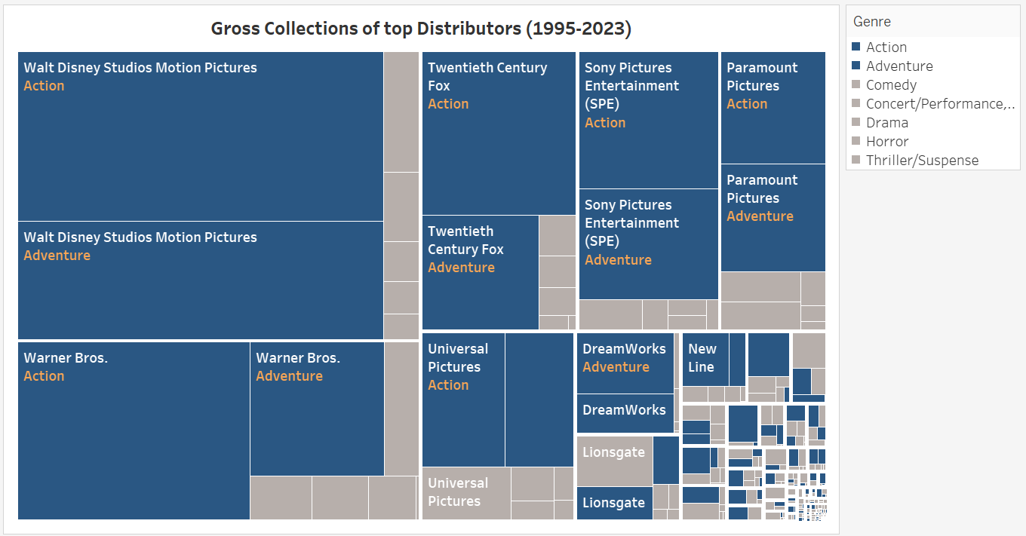
Genres | Distributors | MPAA Ratings | Superheroes | Recommendation
Key Takeaway: The major share of the Gross Collections of the top distributors come from the
Action and Adventure Genres.

Slide 7
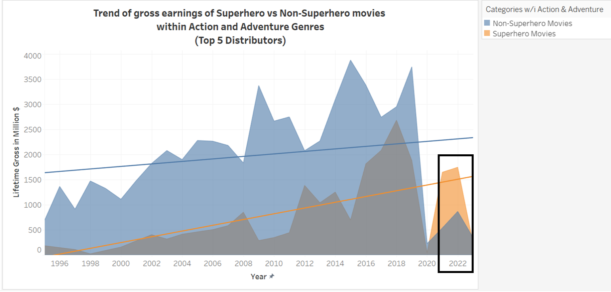

Genres | Distributors | MPAA Ratings | Superheroes | Recommendation
In 2022, the gross earning of Superhero movies was around
2 times
that of the Non-Superhero
Movies.
Key Takeaway: An increasing trend in share of Superhero movies within the Action & Adventure Genres in the last decade.

Slide 8
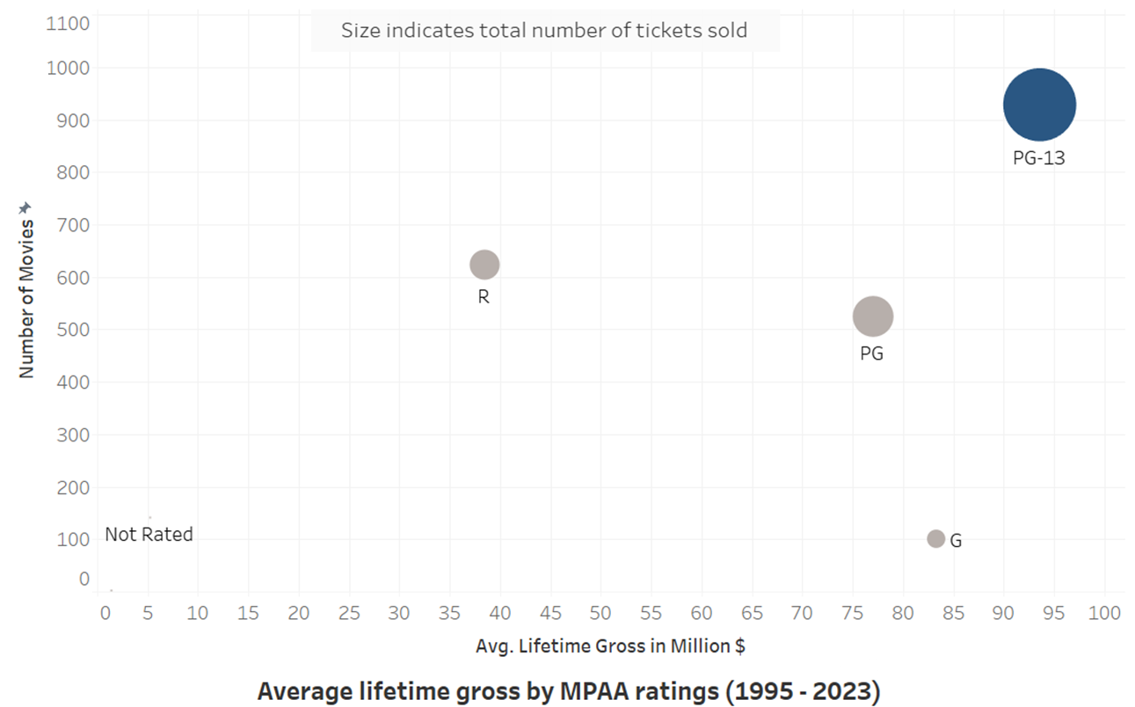
Genres | Distributors | MPAA Ratings | Superheroes | Recommendation
76% of all Superhero movies are rated PG-13. Does it impact the Gross collection?
>55%
of the Lifetime Gross of
Action & Adventure Movies is attributed to PG-13 films.

Slide 9
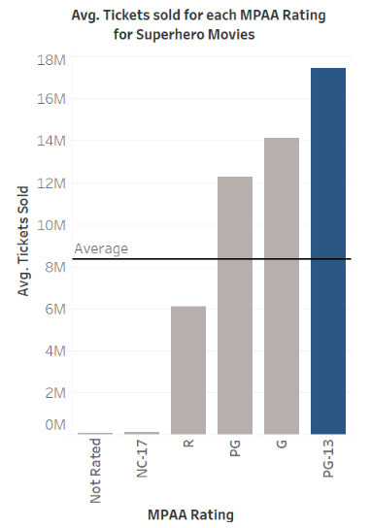

Genres | Distributors | MPAA Ratings | Superheroes | Recommendation
Avg. tickets sold for
PG-13 Superhero movies
Avg. tickets sold for Any Superhero movie
Key Takeaway: PG-13 rating is NOT a limiting factor for a movie’s collection despite restricted audience.

Slide 10
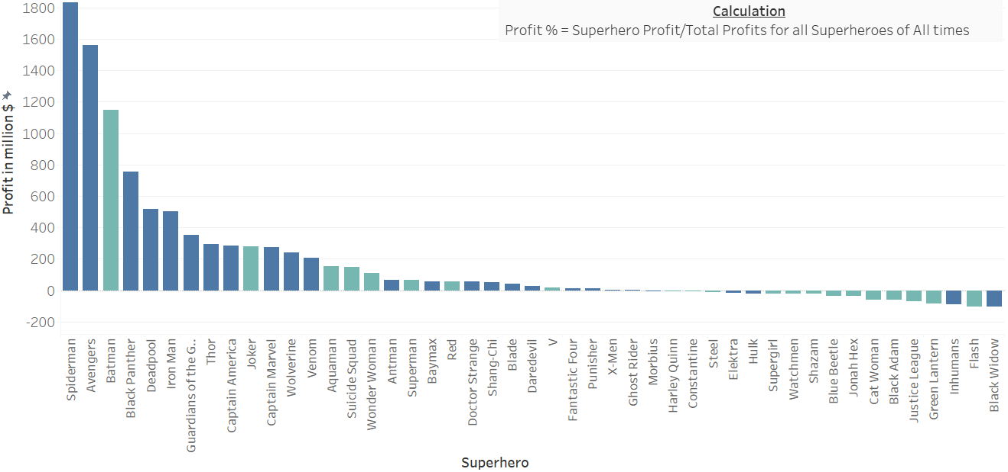
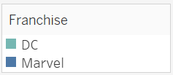
Genres | Distributors | MPAA Ratings | Superheroes | Recommendation
Profit Earned by Superheroes

Slide 11
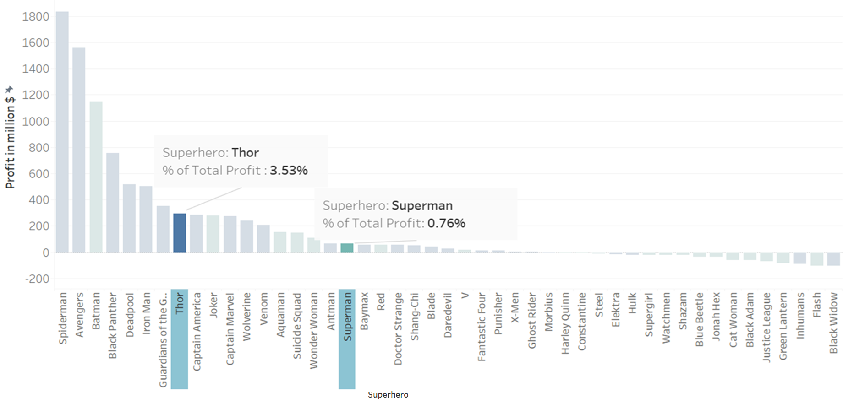
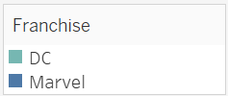
Genres | Distributors | MPAA Ratings | Superheroes | Recommendation
Profitability of Proposed Superheroes

Slide 12
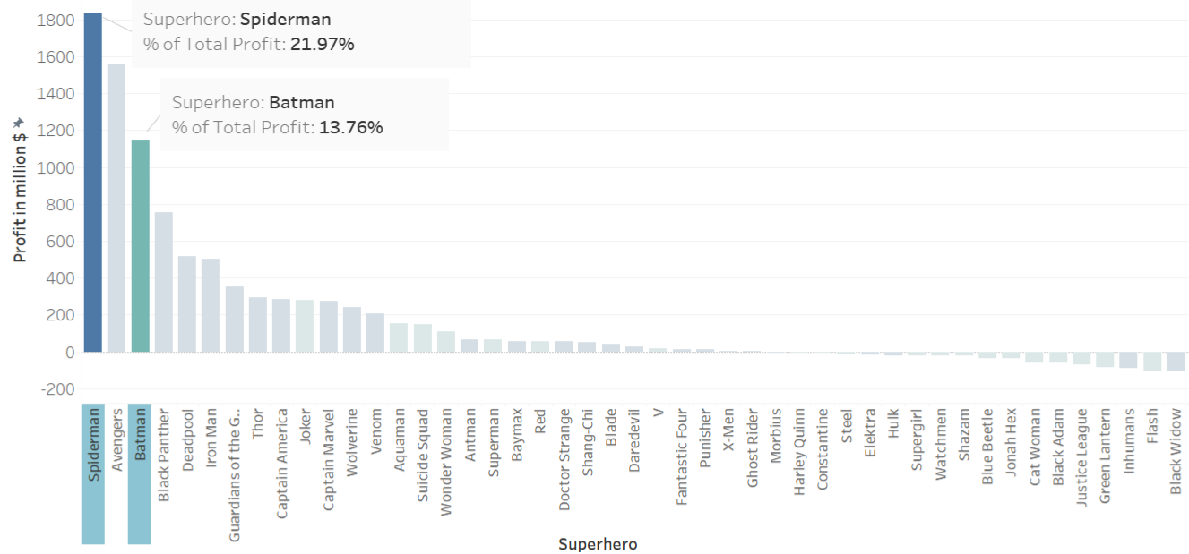
Genres | Distributors | MPAA Ratings | Superheroes | Recommendation
Profitability of Recommended Superheroes

Slide 13

Genres | Distributors | MPAA Ratings | Superheroes | Recommendation
Summarizing, we have enough evidence from the sample data to recommend that:-
Investment in Action and Adventure Genres is profitable
Investment in Superhero movies is profitable
MPAA Rating PG-13 is not a limiting factor for the movie’s collections
Marvel’s Spiderman and DC’s Batman would increase the profitability of the movie

Slide 14
Data Sources
BoxOfficeMojo.com
TheNumbers.com
IMDBPro.com

Slide 15
Q & A ?
Thank You!

